Slide 1
Predictive Analysis

Slide 2
What is Predictive Analysis?
A branch of analytics which uses past data to understand and predict possible future outcomes
Ie. Netflix predicting which movies you will watch next and recommending those to you
Machine Learning is a type of Predictive Analysis

Slide 3
What is Machine Learning?
Machine learning are algorithms which enable computers to learn from data and improve based upon that data without being explicitly programmed to do so.
Require two sets of data to work:
Training data: Data the computers learns from
Test data: Data the computer is evaluated on
We will be exploring two type of machine learning algorithms:
Logistic Regression
Decision Trees

Slide 4
End of Video 1

Slide 5
What is Logistic Regression?
Classification Algorithm designed to assign observations to a discrete or limited number of classes
Ie. Email spam vs. not spam
Types of Logistic Regression:
Binary (Malignant vs. Benign Tumor)
Multi-class (Which cancer stage? Stage 1 vs 2 vs 3 vs 4)
This module will focus on Binary Logistic Regression

Slide 6
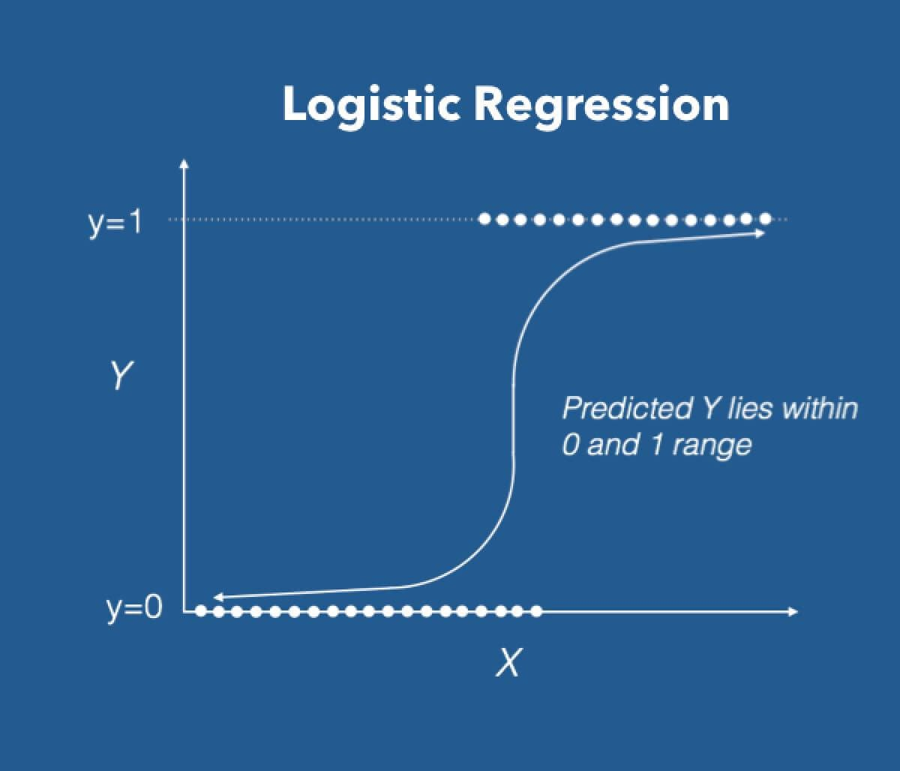
How Does Logistic Regression Work?
Calculates a probability for a particular prediction class using a ‘sigmoid’ or ‘logit’ function
Sigmoid simply means “S-shaped”. This is the shape of the sigmoid function.
Will ‘ingest’ all variables given to it in the data and compute a probability based on those variables

Slide 7
Important Note
Many online resources will delve deep into the math behind logistic regression
For the purpose of this module, you just need to understand that logistic regression will classify an observation to a discrete number of categories
The math behind logistic regression is beyond the scope of this module

Slide 8
Advantages vs. Disadvantages
Advantages:
Simple (compared to other algorithms)
Not resource intensive (computer can quickly make a prediction)
Disadvantages:
Not as powerful as more complex algorithms
Assumes two classes can be classified linearly
Notes:
What do I mean linearly?

Slide 9
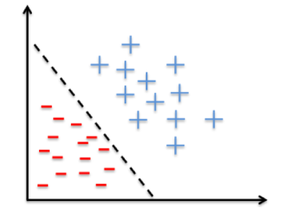
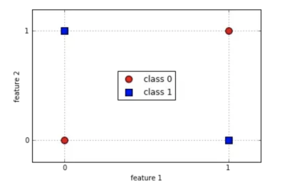
Logistic Regression is Meant to Solve Linear Problems

Slide 10
Exercise 1
Which of the problems below could be a logistic regression classifier be used for?
Predicting whether a patient with be readmitted or not
Predicting a diabetic patients blood sugar value
Predicting whether someone will have a heart attack
Predicting whether a patient will show up to their appointment

Slide 11
Exercise 2
Our module is looking at whether a patient dies during their first 24 hours. Can a logistic regression classifier be applied to this problem?
Yes
No

Slide 12
End of Video 2

Slide 13
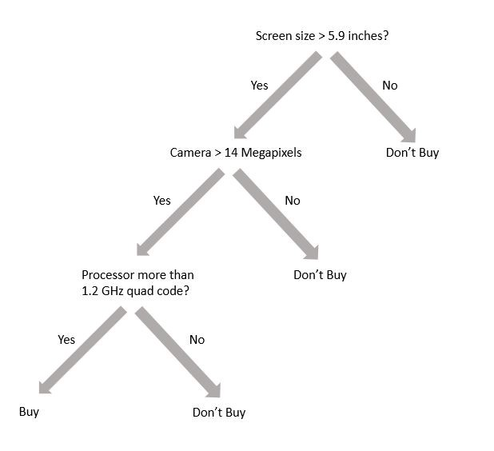
What are Decision Trees?
Decision trees are a flow-chart like structure to make complex decisions
Each branch or split in the tree is a decision based on a variable
Notes:
Picture is a decision tree for deciding whether to buy a phone

Slide 14
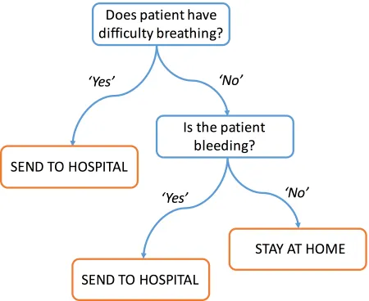
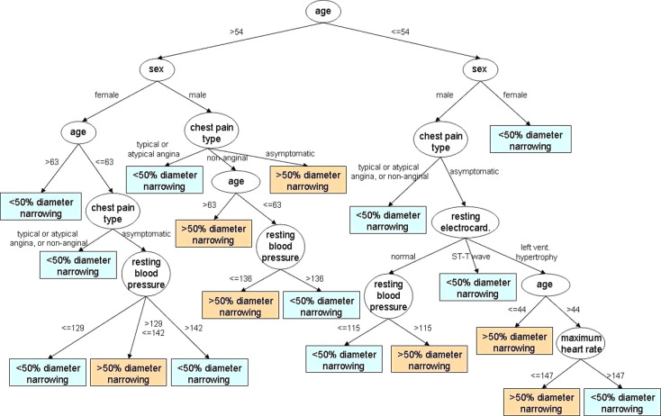
Decision Trees Are Common in Healthcare
Notes:
Decision trees are commonly used in medicine, they can be both simple and complex. The one on the left is a simple decision tree for determining whether a patient should stay home or be sent to the hospital based on if they have difficulty breathing or are bleeding. The decision tree on the right illustrates a complex tree for helping a medical provider determine if a patient’s arteries are more or less than 50% occluded or narrowed.
In the past, decision trees were manually created by people. However, in machine learning, decision trees are automatically created using past data. Computers can quickly create incredibly complex trees in seconds.

Slide 15
Regression and Classification Trees
Unlike logistic regression, decision trees can predict both numerical values (regression trees) and predictions with a discrete number of categories (classification trees)
We will be focusing on classification trees

Slide 16
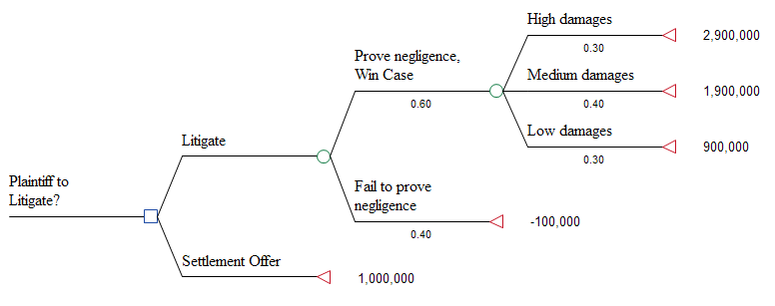
Decision Tree Examples

Slide 17
Advantages vs. Disadvantages
Advantages
Simple
Intuitive
Easy to explain
Disadvantages
Slower to train
Can have overly complex trees
Small changes can lead to large differences in tree structure

Slide 18
Exercise
Is this a regression tree or classification tree?

Slide 19
Exercise
For our module we will be determining if patients die within the first 24 hours. What kind of tree should we use to make this prediction?
Regression Tree
Classification Tree

Slide 20
End of Video 3

Slide 21
Evaluation: Sensitivity, Specificity, and ROC Curves
Evaluation is critical for predictive analysis
Evaluating models is how we can determine which approach is better
We will cover three evaluation metrics in this module:
Accuracy
Sensitivity
Specificity
Receiver Operating Characteristics (ROC) Curves

Slide 22
Confusion Matrix
Confusion Matrix – a table used to describe or evaluate the performance of a machine learning model
2x2 table plotting combination of predicted and actual values

Slide 23
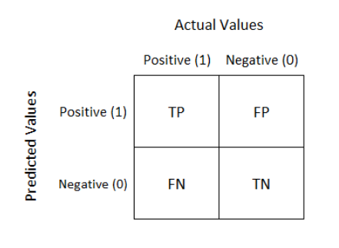
Confusion Matrix (cont.)
True Positive (TP) – Correct Positive Prediction
True Negative (TN) – Correct Negative Prediction
False Positive (FP) – Incorrect Negative Prediction
False Negative (FN) – Incorrect Negative Prediction

Slide 24
Confusion Matrix Example
Say you are trying to predict whether patients actually have a disease
Say 100 people are correctly predicted to have the disease. How would you fill in the table?
 |  | Actual Disease Status
 |  | No Disease | Has Disease
Predicted Disease Status | No Disease
 | Has Disease |  | 100

Slide 25
Confusion Matrix Example (cont.)
Say you are trying to predict whether patients actually have a disease
Say 10 people are incorrectly predicted to have the disease. How would you fill in the table?
 |  | Actual Disease Status
 |  | No Disease | Has Disease
Predicted Disease Status | No Disease |  | 10
 | Has Disease |  | 100

Slide 26
Confusion Matrix Example (cont.)
Say you are trying to predict whether patients actually have a disease
Say 50 people are correctly predicted to not have the disease. How would you fill in the table?
 |  | Actual Disease Status
 |  | No Disease | Has Disease
Predicted Disease Status | No Disease | 50 | 10
 | Has Disease |  | 100

Slide 27
Confusion Matrix Example (cont.)
Say you are trying to predict whether patients actually have a disease
Say 5 people are incorrectly predicted to not have the disease. How would you fill in the table?
 |  | Actual Disease Status
 |  | No Disease | Has Disease
Predicted Disease Status | No Disease | 50 | 10
 | Has Disease | 5 | 100

Slide 28
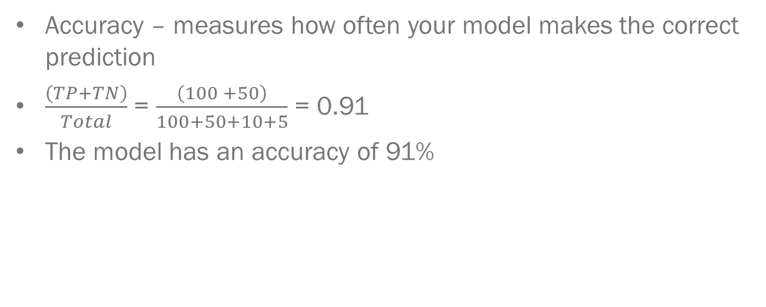
Accuracy
Accuracy – measures how often your model makes the correct prediction
$\frac{\left(TP+TN\right)}{Total}$ = $\frac{\left(100 +50\right)}{100+50+10+5}$ = 0.91
The model has an accuracy of 91%
 |  | Actual Disease Status
 |  | No Disease | Has Disease
Predicted Disease Status | No Disease | 50 | 10
 | Has Disease | 5 | 100

Slide 29
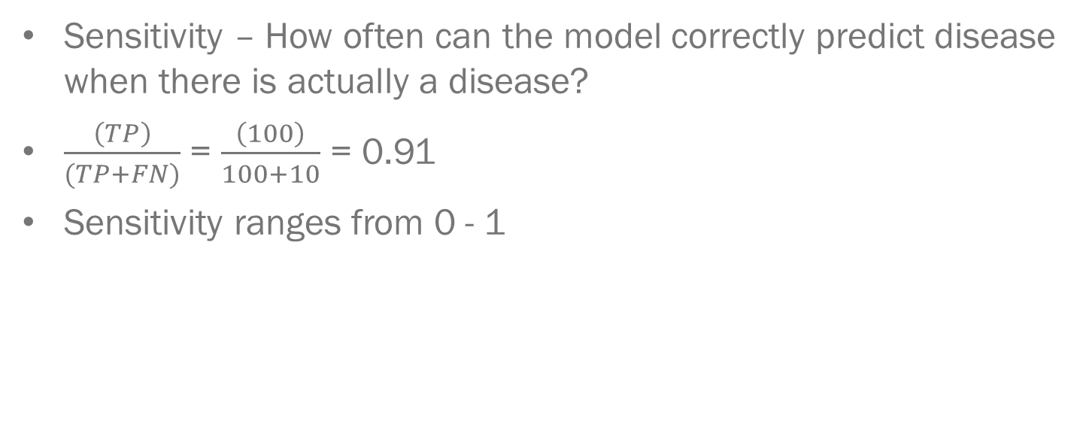
Sensitivity
Sensitivity – How often can the model correctly predict disease when there is actually a disease?
$\frac{\left(TP\right)}{(TP+FN)}$ = $\frac{\left(100\right)}{100+10}$ = 0.91
Sensitivity ranges from 0 - 1
 |  | Actual Disease Status
 |  | No Disease | Has Disease
Predicted Disease Status | No Disease | 50 | 10
 | Has Disease | 5 | 100

Slide 30
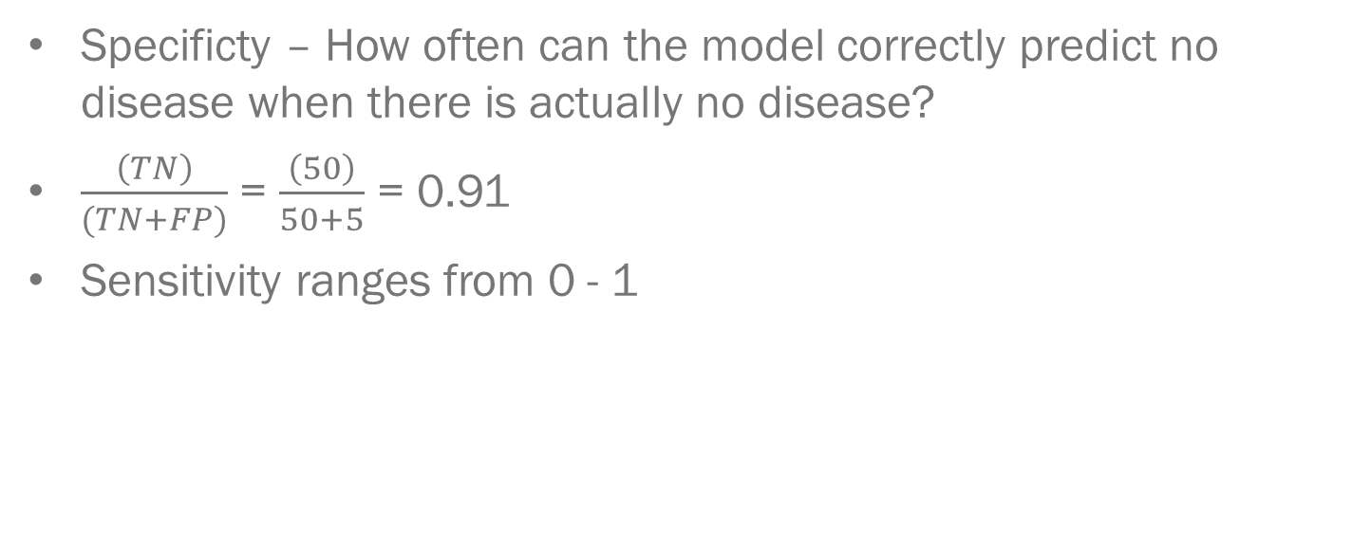
Specificity
Specificty – How often can the model correctly predict no disease when there is actually no disease?
$\frac{\left(TN\right)}{(TN+FP)}$ = $\frac{\left(50\right)}{50+5}$ = 0.91
Sensitivity ranges from 0 - 1
 |  | Actual Disease Status
 |  | No Disease | Has Disease
Predicted Disease Status | No Disease | 50 | 10
 | Has Disease | 5 | 100

Slide 31
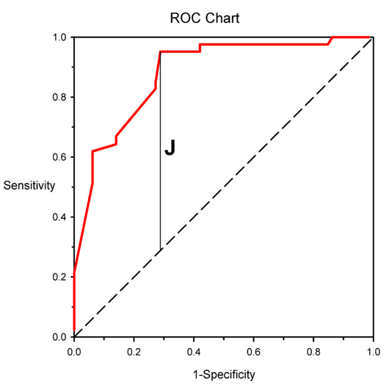
Receiver Operating Characteristics (ROC) Curves
A visual way to evaluate the performance of a model taking into account both sensitivity and specificity!

Slide 32
Receiver Operating Characteristics (ROC) Curves (Cont.)
The closer to the top left that the classifier is, the better its performance
Dashed line in the middle is the same as 50-50 guessing

Slide 33
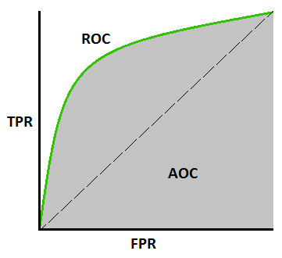
Area Under the Curve (AUC)
The area under the curve (AUC) of an ROC curve will give us a quantitative measure about how well the model performs
Ranges from 0 - 1
Higher the AUC value, the better the predictive ability
Dashed line in the middle has an AUC value of 0.5

Slide 34
Exercise
For the Confusion Matrix below, please calculate the following metrics
Accuracy
Sensitivity
Specificity
Pretend case is predicting mortality from the module

Slide 35
Exercise
Compare ROC curves, which one is better

Slide 36
End of Video 4

